Slide 1

T-BOX, A-BOX and the like
Computer Science Department
University of Verona - Italy

Slide 2
The architecture of a DL system

Slide 3
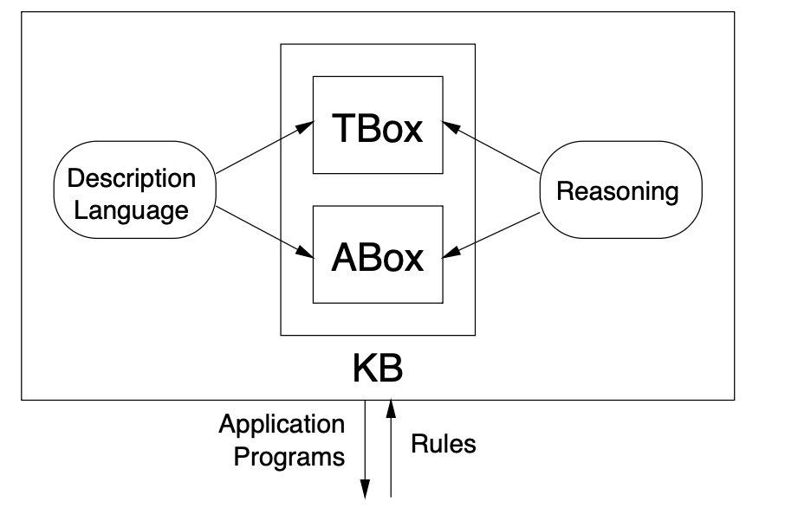
T-box and A-box

Slide 4
The T-Box
A terminology is a set of definitions, as we partly devised above;
The T-box is the set of definitions and similar relationships asserted upon DL expressions

Slide 5
What is there in a T-box?
Proper definitions
Inclusion axioms
Generalised Inclusion Axioms

Slide 6
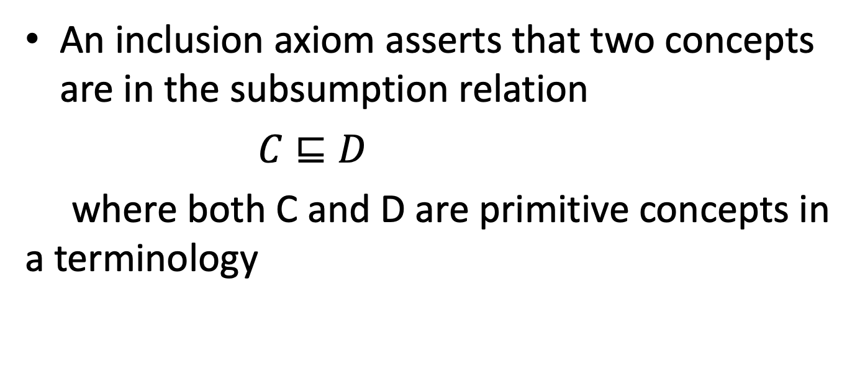
Inclusion axioms
An inclusion axiom asserts that two concepts are in the subsumption relation
$C⊑D$
where both C and D are primitive concepts in a terminology

Slide 7
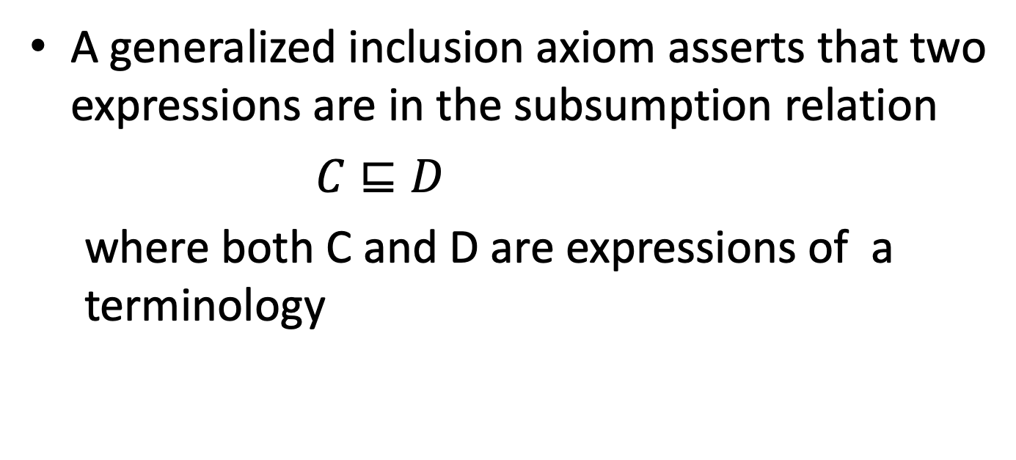
Generalized inclusion axioms
A generalized inclusion axiom asserts that two expressions are in the subsumption relation
$C⊑D$
where both C and D are expressions of a terminology

Slide 8
Rewriting GIA
When we have definitions of at least one element appearing in a GIA, that means the very same element can be rewritten into another, equivalent GIA, where the expression appearing on the right of the definition substitues the element itself

Slide 9
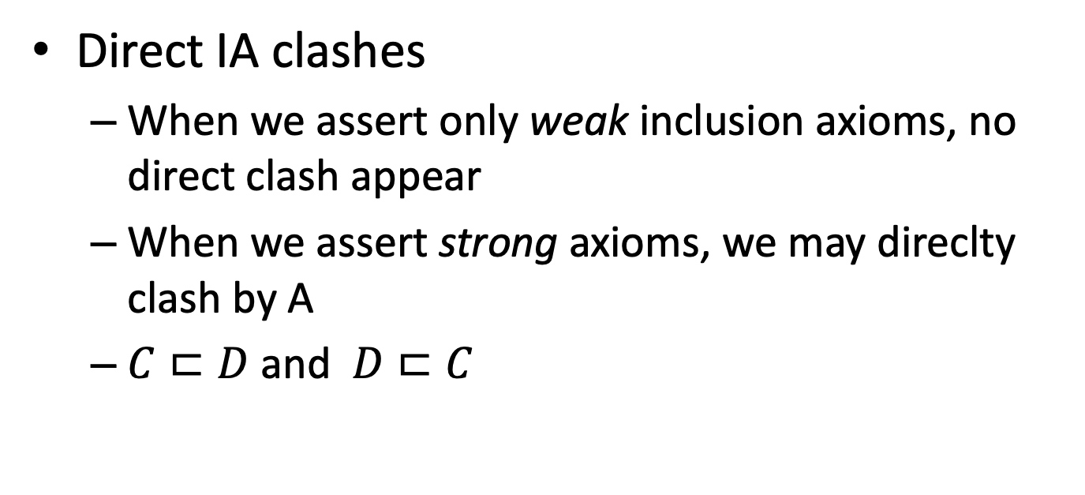
Examples of clashes
Direct IA clashes
When we assert only weak inclusion axioms, no direct clash appear
When we assert strong axioms, we may direclty clash by A
$C⊏D$ and $D⊏C$

Slide 10
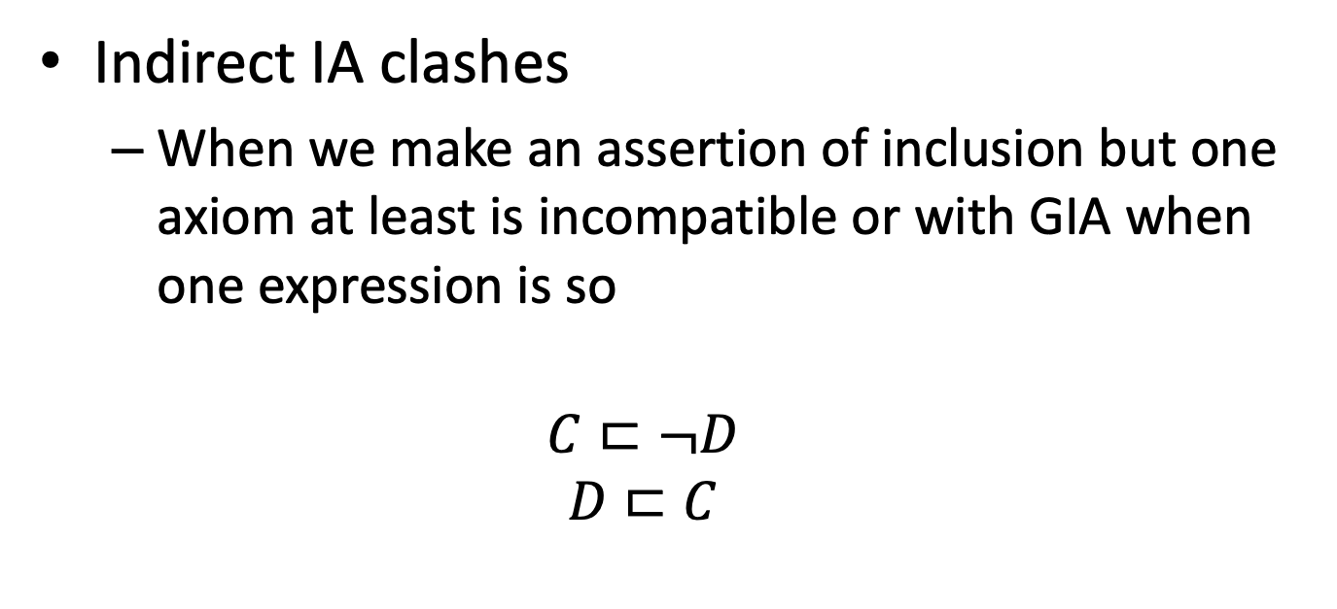
Examples of clashes
Indirect IA clashes
When we make an assertion of inclusion but one axiom at least is incompatible or with GIA when one expression is so
$$C⊏¬D$$
$$D⊏C$$

Slide 11
Note on empty definitions
An empty definition is a definition of a concept as the empty set
This is NOT a clash
A clash occurs when you define a concept in a way that is incompatible with the other definitions, or inclusion axioms

Slide 12
World descriptions
The A-box contains, instead, assertions about the world, as potentially related to existing T-boxes

Slide 13
What is there in an A-box?
Concept instantiation
Relation instantiation

Slide 14
Instantiation clashes
You may assert one individual to belong to a class and to its complement

Slide 15
First picture interpreted

Slide 16
Exntending the architecture

Slide 17
The Role Box
T-Box
Description language
R-Box
Reasoning
A-Box

Slide 18
What is there in an R-box?
Proper role definitions
Role inclusion axioms
Generalized role inclusion axioms
Role property assertions

Slide 19
Role properties
Roles can be asserted to be
Functional (every individual has at most one other individual related)
Reverse functional (one individual is the image of at most one individual)
Reflexive
Symmetric
Anti-symmetric
Reflexive-transitive
Transitive

Slide 20
Clashes
You clash in the R-box when asserting a role to be in opposite inclusion axioms exactly as in the T-box
You may clash on the T-box, for a definition in the R-box, when you define a concept based on restrictions that are incompatible with the definition of a role
You may clash on the A-box when asserting an individual to be in a given relation with another individual, in a way that clashes the role properties

